Slide 1
Lab 5
Kernel Module
  TA:Yu-Chen Jheng
  Professor: Hsung-Pin Chang
  Operating System Lab

Slide 2
What is a kernel module ?
Modules are pieces of code that can be loaded and unloaded into the kernel upon demand.
They extend the functionality of the kernel without the need to recompile and reboot the system.
Example
  One type of module is the device driver, which allows the kernel to access hardware connected to the system.
  Without modules, we would have to build monolithic kernels and add new functionality directly into the kernel image.
NCHU System & Network Lab

Slide 3
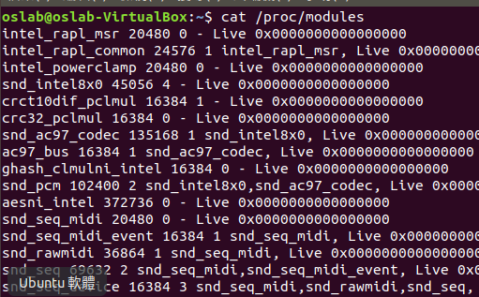
Files relate to modules
NCHU System & Network Lab
Notes:
Cat 印出檔案內容

Slide 4
Creating a kernel module
NCHU System & Network Lab

Slide 5
Preparation
To build a kernel module, we need “gcc”, “make” and linux header files.
By default, Ubuntu installed these for us.
However, if your OS doesn’t have, install gcc, make and linux header files by yourself:
sudo apt-get install gcc make linux-headers-`uname -r`
  For instance: `uname –r` = 5.3.0-28-generic, then install
  linux-headers-5.3.0-28-generic (Must match the kernel version)
NCHU System & Network Lab
Notes:
$ sudo apt-get update
$ sudo apt-get upgrade
$ sudo apt-get install build-essential

Slide 6
Simplest module: hello_module.c
/folder
  hello_module.c
  Makefile
NCHU System & Network Lab

Slide 7
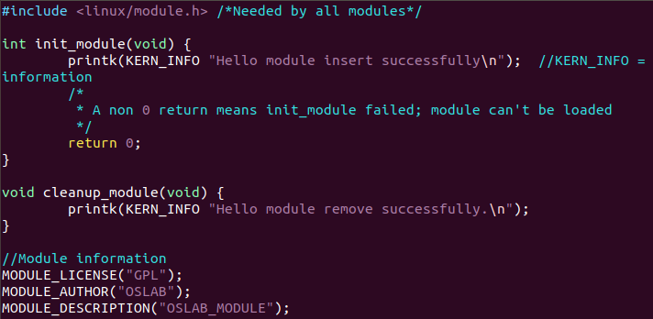
hello_module.c
NCHU System & Network Lab

Slide 8
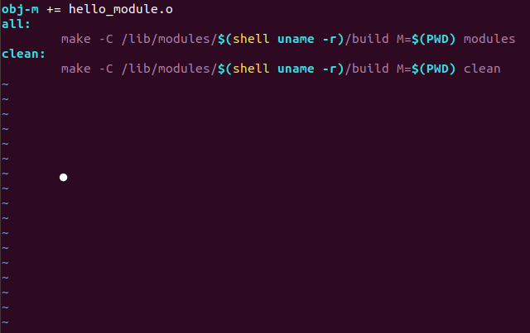
Makefile
Should match source name
↖Should match the source name
NCHU System & Network Lab

Slide 9
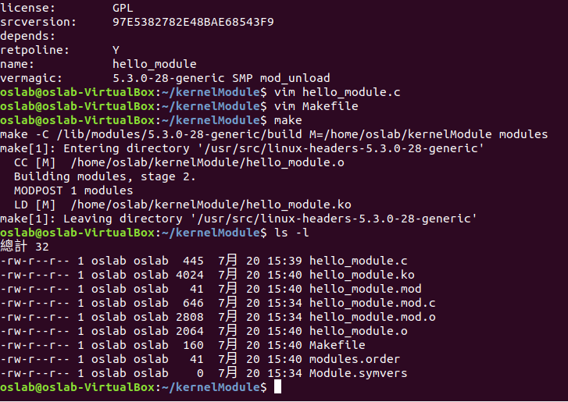
Use “make” to make the module.
NCHU System & Network Lab

Slide 10
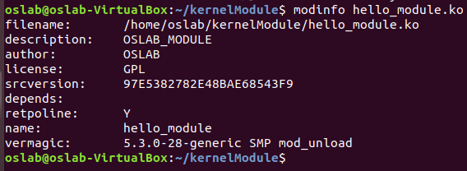
See module information
Use “modinfo” to see the module information.
NCHU System & Network Lab

Slide 11
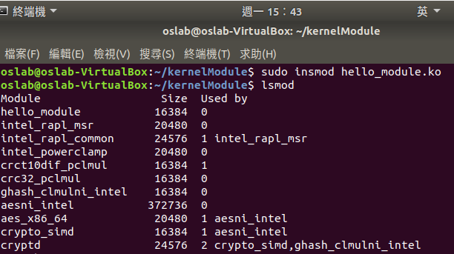
Insert module into kernel
Use “insmod” to insert module into kernel (root needed)
“lsmod” to list modules.
NCHU System & Network Lab

Slide 12
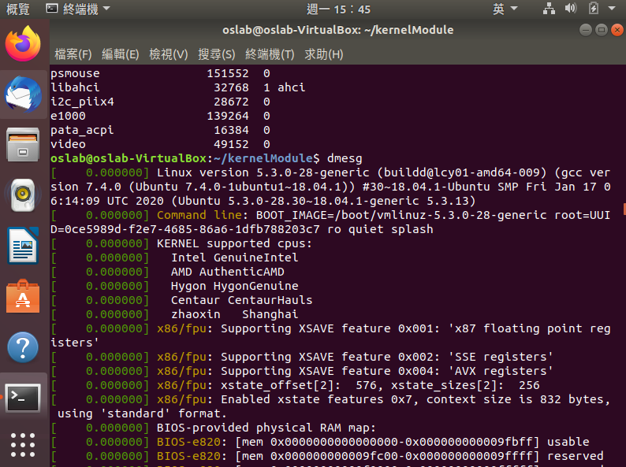
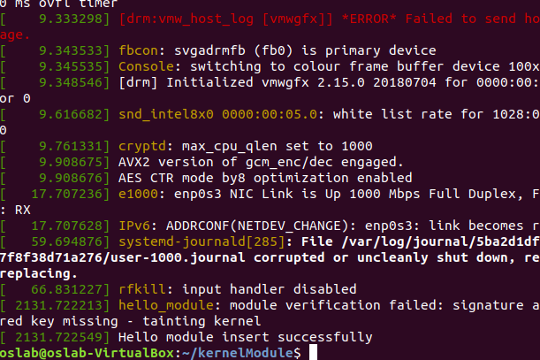
Use “dmesg” to see the log file.
(You can use “dmesg | tail” to view tail only.)
NCHU System & Network Lab

Slide 13
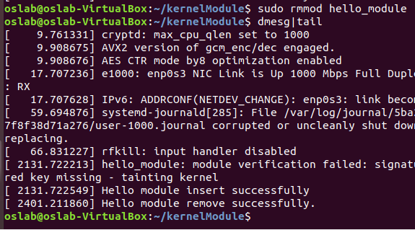
Remove module from kernel
Use “rmmod” to remove module. (root needed)
The Hello module has been removed.
NCHU System & Network Lab

Slide 14
Passing command line arguments to a module
NCHU System & Network Lab

Slide 15


Module Parameters: Passing Command Line Arguments to a Module
Use the following macro to declare parameters
module_param(name, type, perm)
  name : variable name
  type : variable type
  perm : not discuss here, set to 0
MODULE_PARM_DESC(name, desc)
  name: variable name
  desc: variable description
  Provide a parameter information for users, but not actually declare one.

Slide 16
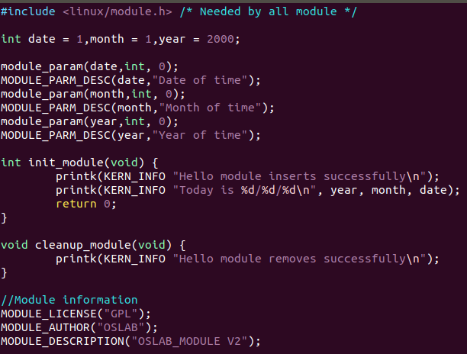
Declare parameters in module.
NCHU System & Network Lab

Slide 17
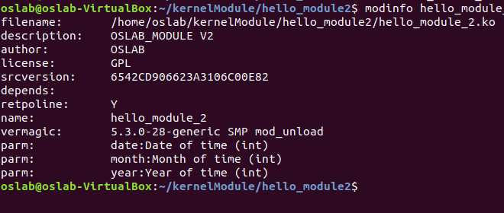
We can see the parameters this module has which are defined by MODULE_PARM_DESC() by using “modinfo.”
NCHU System & Network Lab

Slide 18
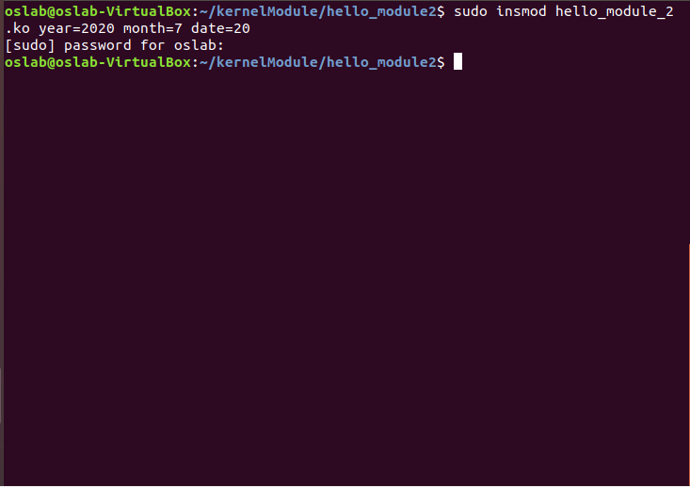
Use command line to pass arguments to the module.
NCHU System & Network Lab

Slide 19
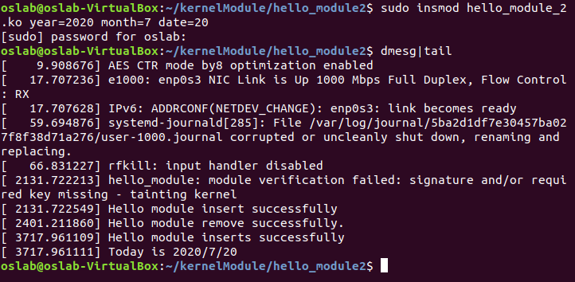
To see the result in log file.
NCHU System & Network Lab

Slide 20
Export Symbol
NCHU System & Network Lab

Slide 21
Exporting Your Symbols
Symbol
  Function symbol and variable symbol,etc.
How to export a symbol in your module?
  Use the EXPORT_SYMBOL(name) macro

Slide 22
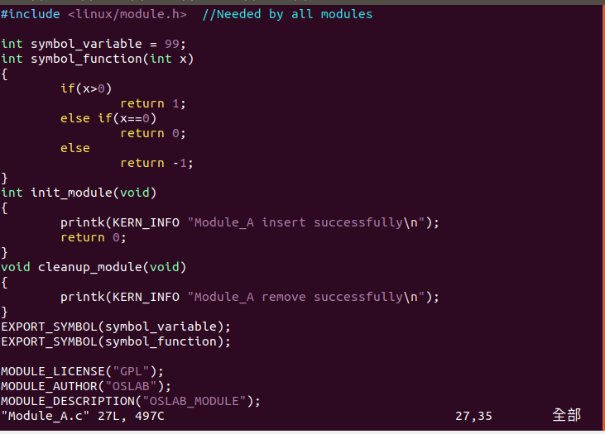
Export variable
Export fuction
variable symbol
function symbol
Module_A : export a variable symbol & a function symbol.
NCHU System & Network Lab

Slide 23
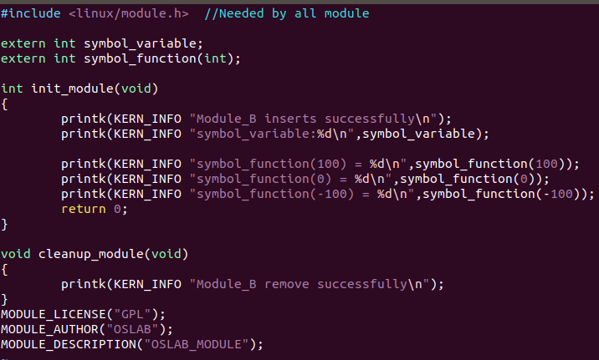
Module_B: use the symbols exported by MODULE_A.
NCHU System & Network Lab

Slide 24
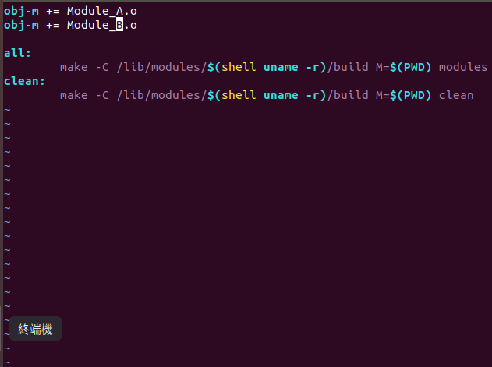
Makefile
We can compile module_a and module_b at once by editing the makefile.
NCHU System & Network Lab

Slide 25
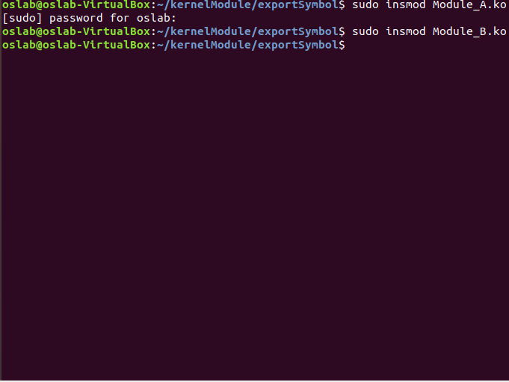

Insert two modules
We should insert MODULE_A before MODULE_B because MODULE_B uses symbols exported by MODULE_A.
NCHU System & Network Lab

Slide 26
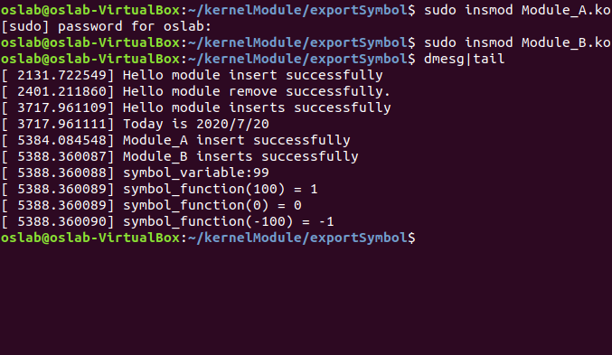
To see the result in log file.
NCHU System & Network Lab

Slide 27
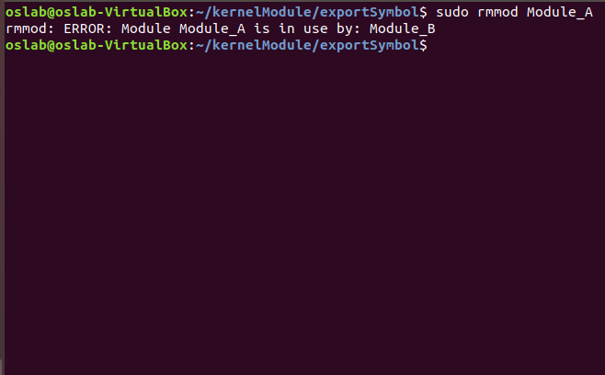
Remove two modules
Before removing MODULE_A, all modules depends on MODULE_A (i.e., uses symbols exported by MODULE_A) should be removed first.
NCHU System & Network Lab

Slide 28
Exercise
Create three modules
  Module A
    Export a function symbol
  Module B
    Export a variable symbol
    Call the function exported by Module A
  Module C
    Use the variable exported by Module B
    Declare it as a parameter
  Notice: load order is A, B, then C
NCHU System & Network Lab

Slide 29
Exercise (cont.)
Details
  Module A : (30pts)
    Export a function symbol
      The function accept an integer argument.
      Use printk() to show the comparison result between 100 and the input argument.
        If argument > 100: return 1
        If argument = 100: return 0
        If argument < 100: return -1
NCHU System & Network Lab

Slide 30
Exercise (cont.)
  Module B : (30pts)
    Export a variable symbol
      Declare an int variable (value=56) and export it as an exported symbol.
    Call the function exported by Module A
      Use the variable declared above as an argument to the function exported by Module A.
NCHU System & Network Lab

Slide 31
Exercise (cont.)
  Module C : (30pts)
    Use the variable exported by Module B
      Hint: extern statement.
    Declare it as a parameter
      Pass a command line argument to set the variable.
      Show the new value by printk().
NCHU System & Network Lab

Slide 32

Result
NCHU System & Network Lab

Slide 33
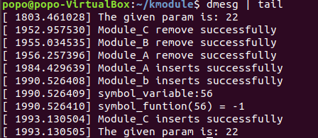
Result
NCHU System & Network Lab

Slide 34
Reference
The Linux Kernel Module Programming Guide
  http://tldp.org/LDP/lkmpg/2.6/html/
Linux kernel module and TCP/IP program design
NCHU System & Network Lab

